Slide 1
Laser-Based Wireless Power Transmission: Photovoltaic Cells Extension Boards
Haruka Kido
University of North Dakota
EE481. Senior Design II

Slide 2
PV Cell Form Factors:
39.37008 mils = 1 mm
1 mil = 0.0254 mm (millimeter)
1 cm x 1 cm (10 mm x 10 mm) MIH® VMJ PV Cell Form Factor (Part #: 5S1010.4)
2.5 cm x 2.5 cm (25 mm x 25 mm) PV Cell Form Factor
5 cm x 5 cm (50 mm x 50 mm) PV Cell Form Factor
Total number of form factors: 3
PV Cell Electrical Arrangement Types:
Isolated: Configurable Externally for Adaptive Methods
Series
Parallel
Total number of arrangements: 3
Total number of PV Cell Extension Boards: 3
Total number of possible board prototypes: 9
Total number of design files for board prototypes: 7 (due to adjustable dimensions and tolerances from same circuitries)

Slide 3
Specifications:
Use all 3 PV Cell form factors (1 cm x 1 cm, 2.5 cm x 2.5 cm, and 5 cm x 5 cm) as spacing for PV cells to be soldered onto the fabricated adaptor boards.
Use 8 solder pads per PV Cell form factor.
Use 8 output traces from the 8 PV Cell electrodes, from which 8 solder pads should be at the end points so output wires can be soldered to for breadboard testing of the output load.
Form factor 3 have PV cell electrodes (as two 5 mm x 5 mm solder pads) at the center of the PV cell; Therefore, the form factor 3 design requires different tolerance ratios from that of the form factors 1 and 2 design. To obtain electrical connectivity, use solder paste from a syringe.

Slide 4
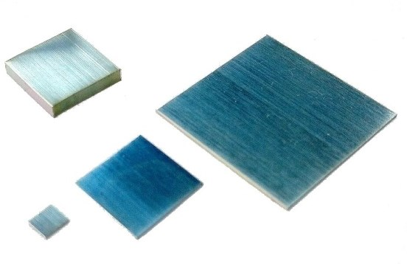
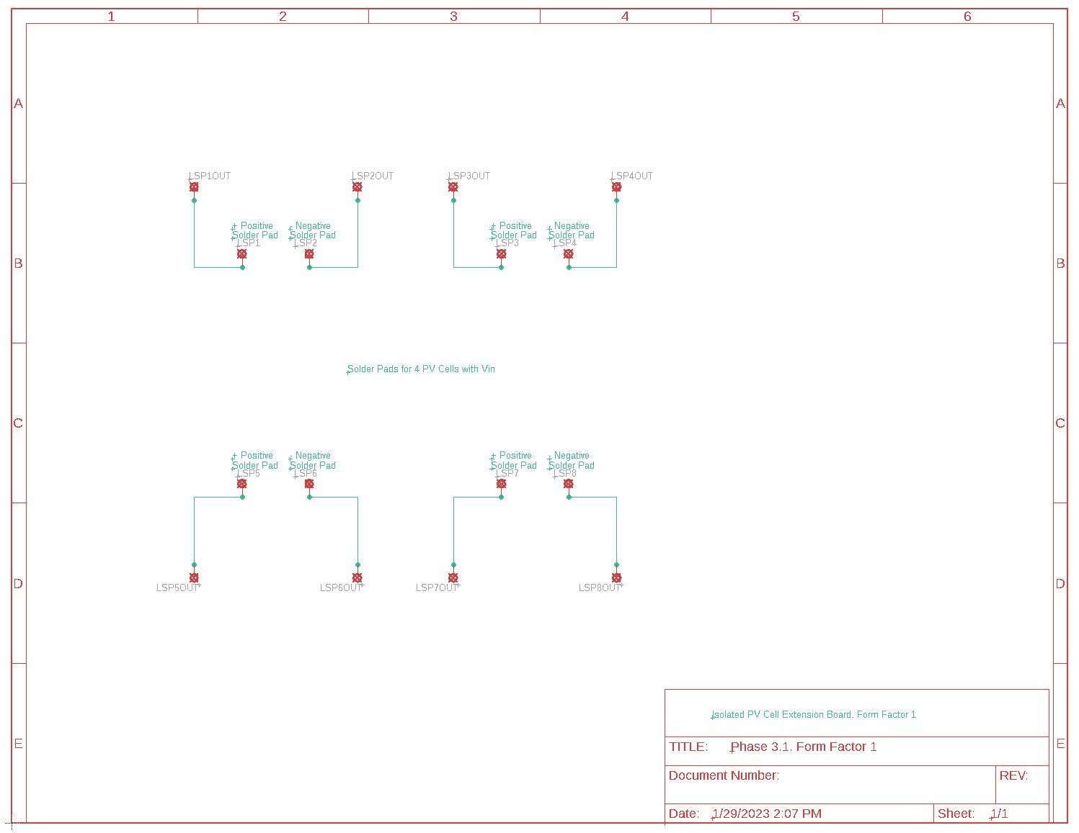
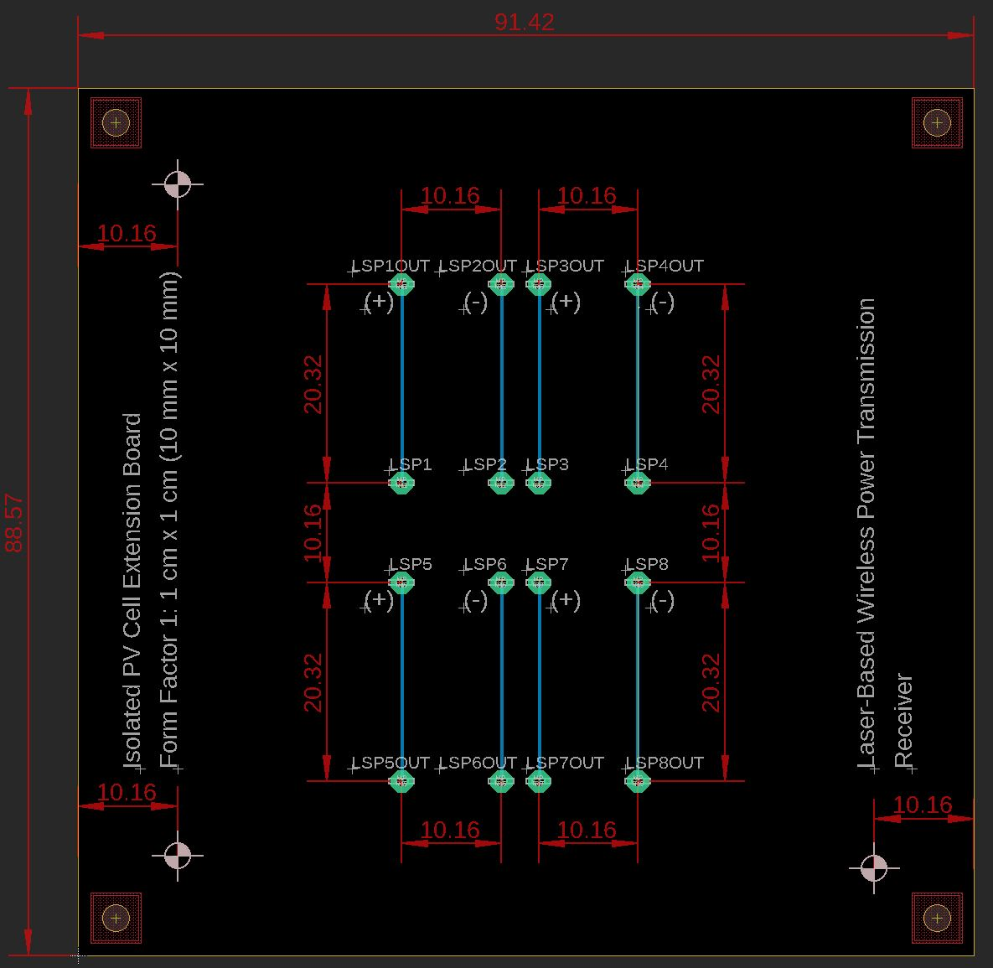
PV Cell Extension Board 1: Form Factor 1: 1 cm x 1 cm (10 mm x 10 mm)

Slide 5
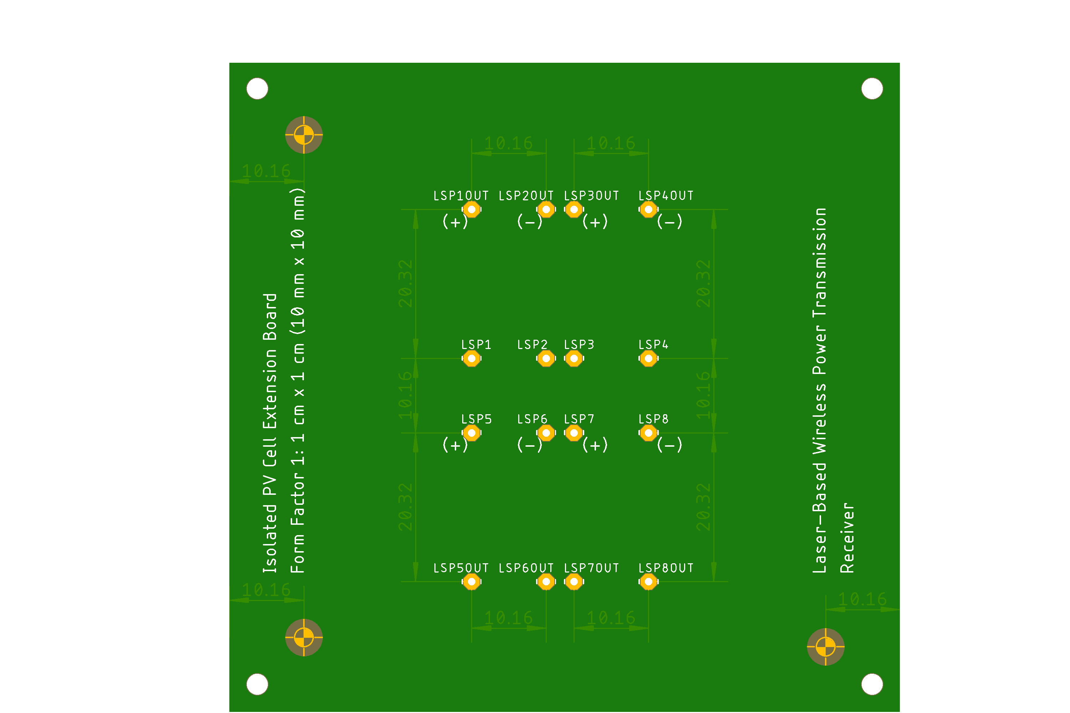
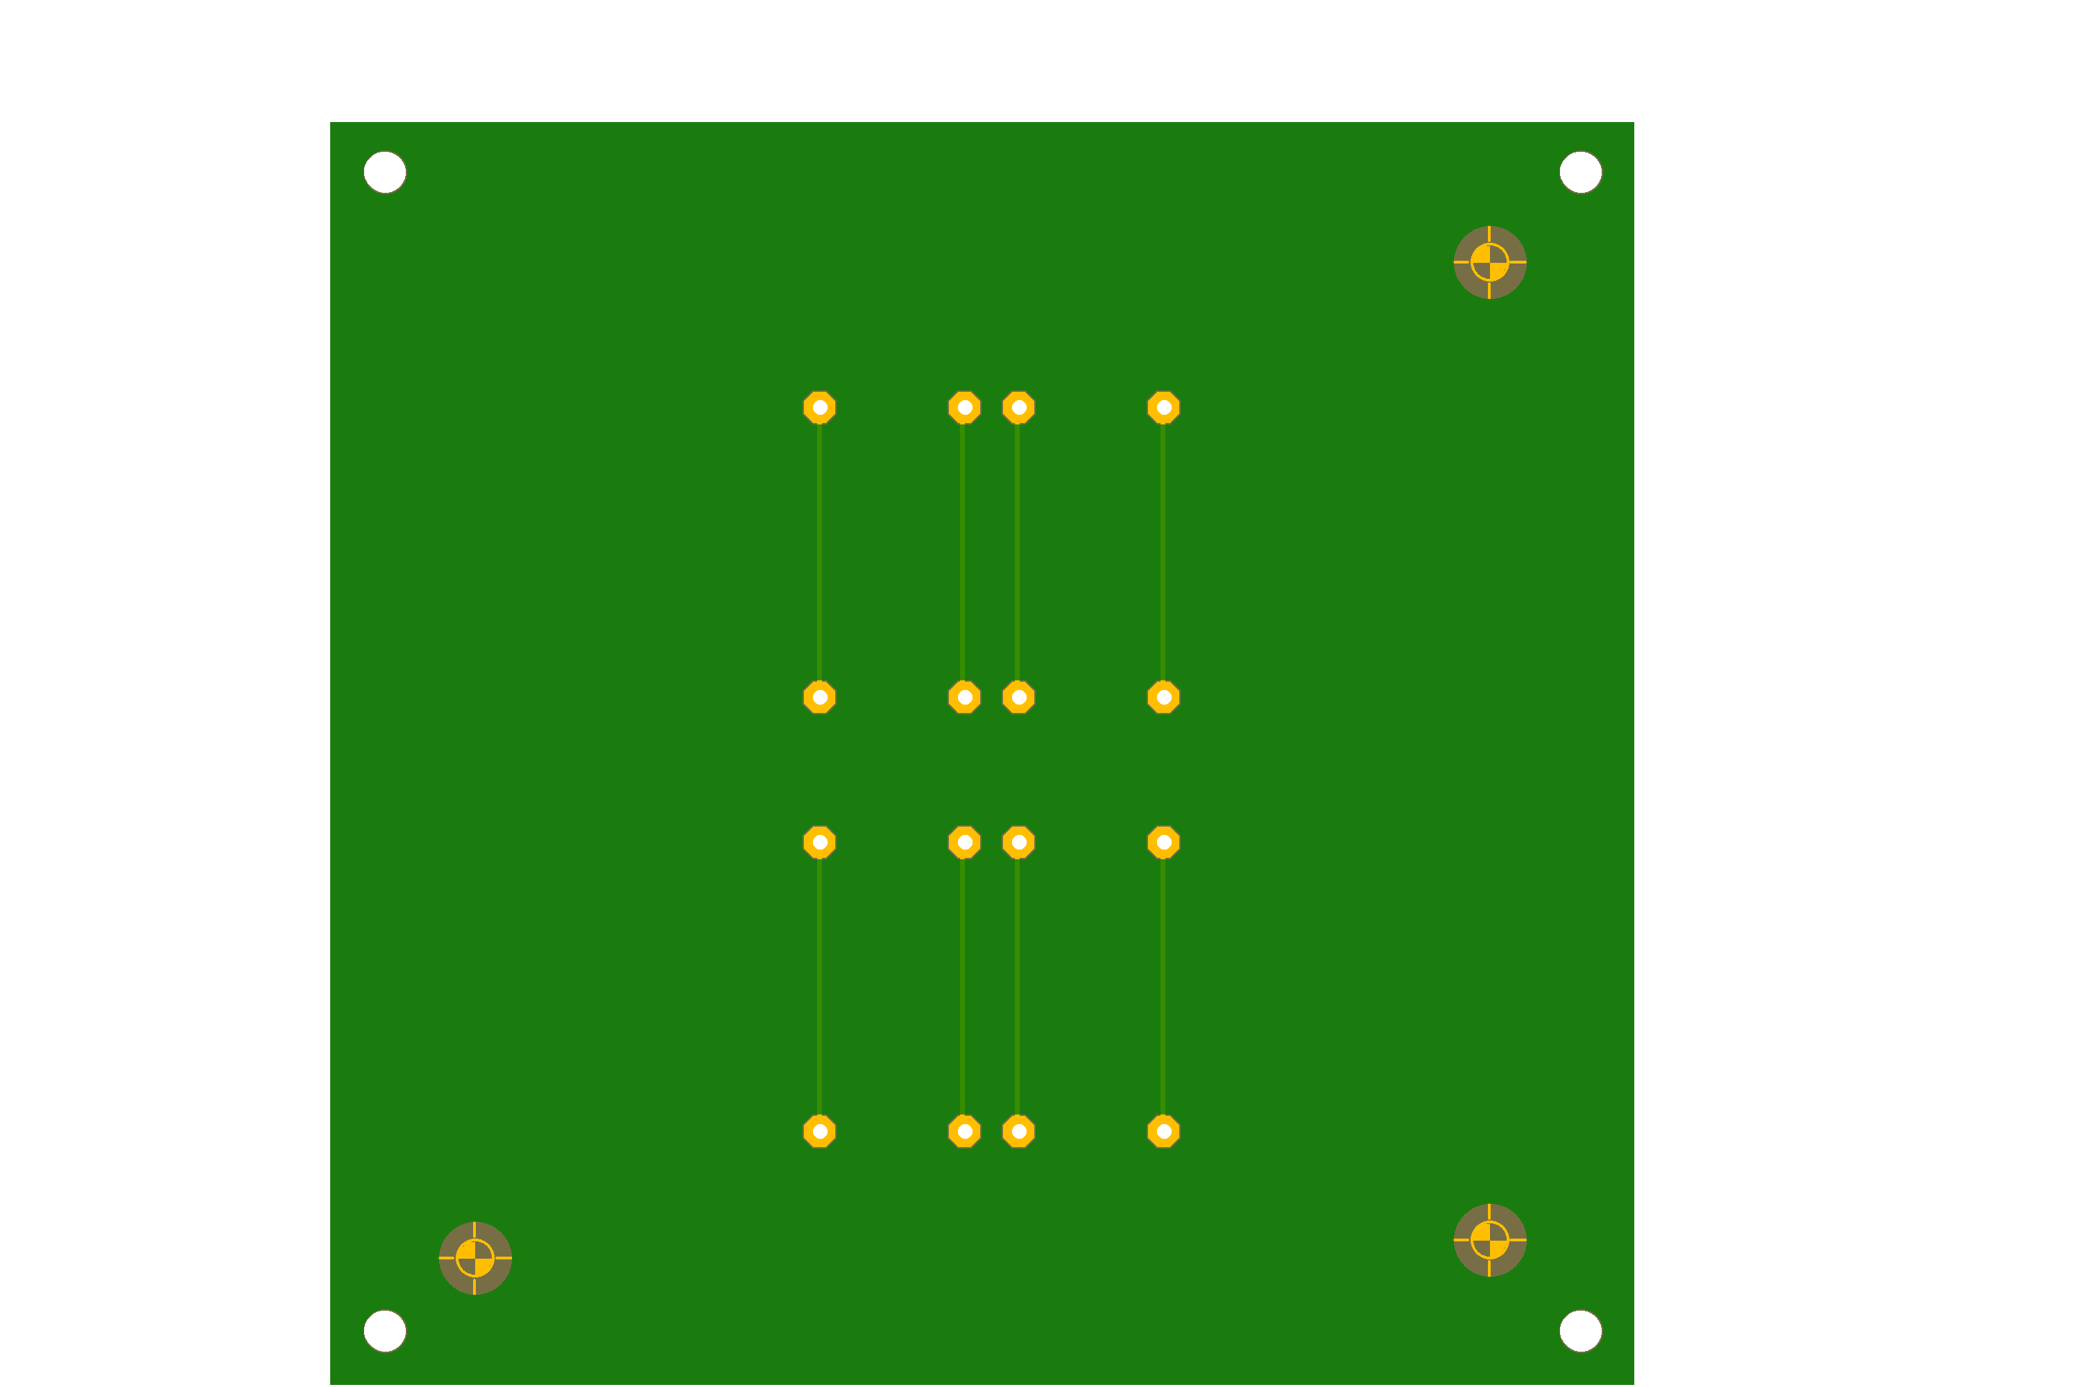
Top
Bottom

Slide 6
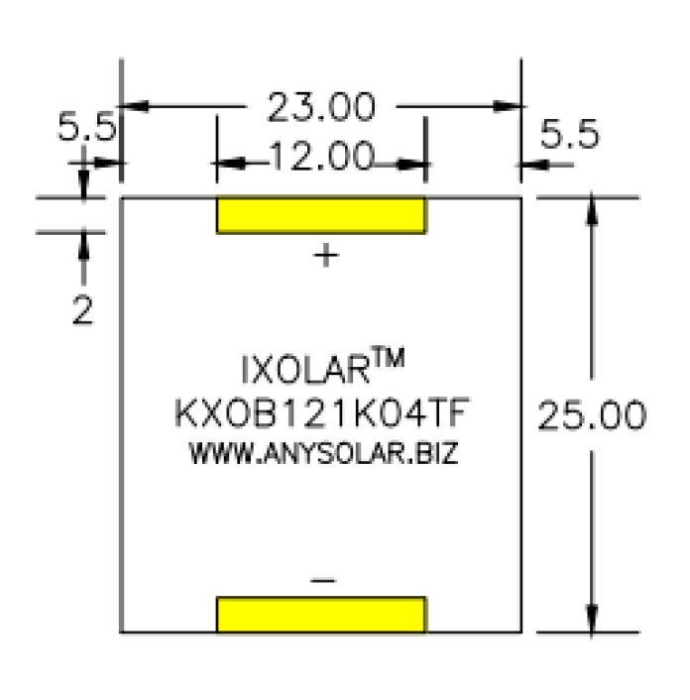
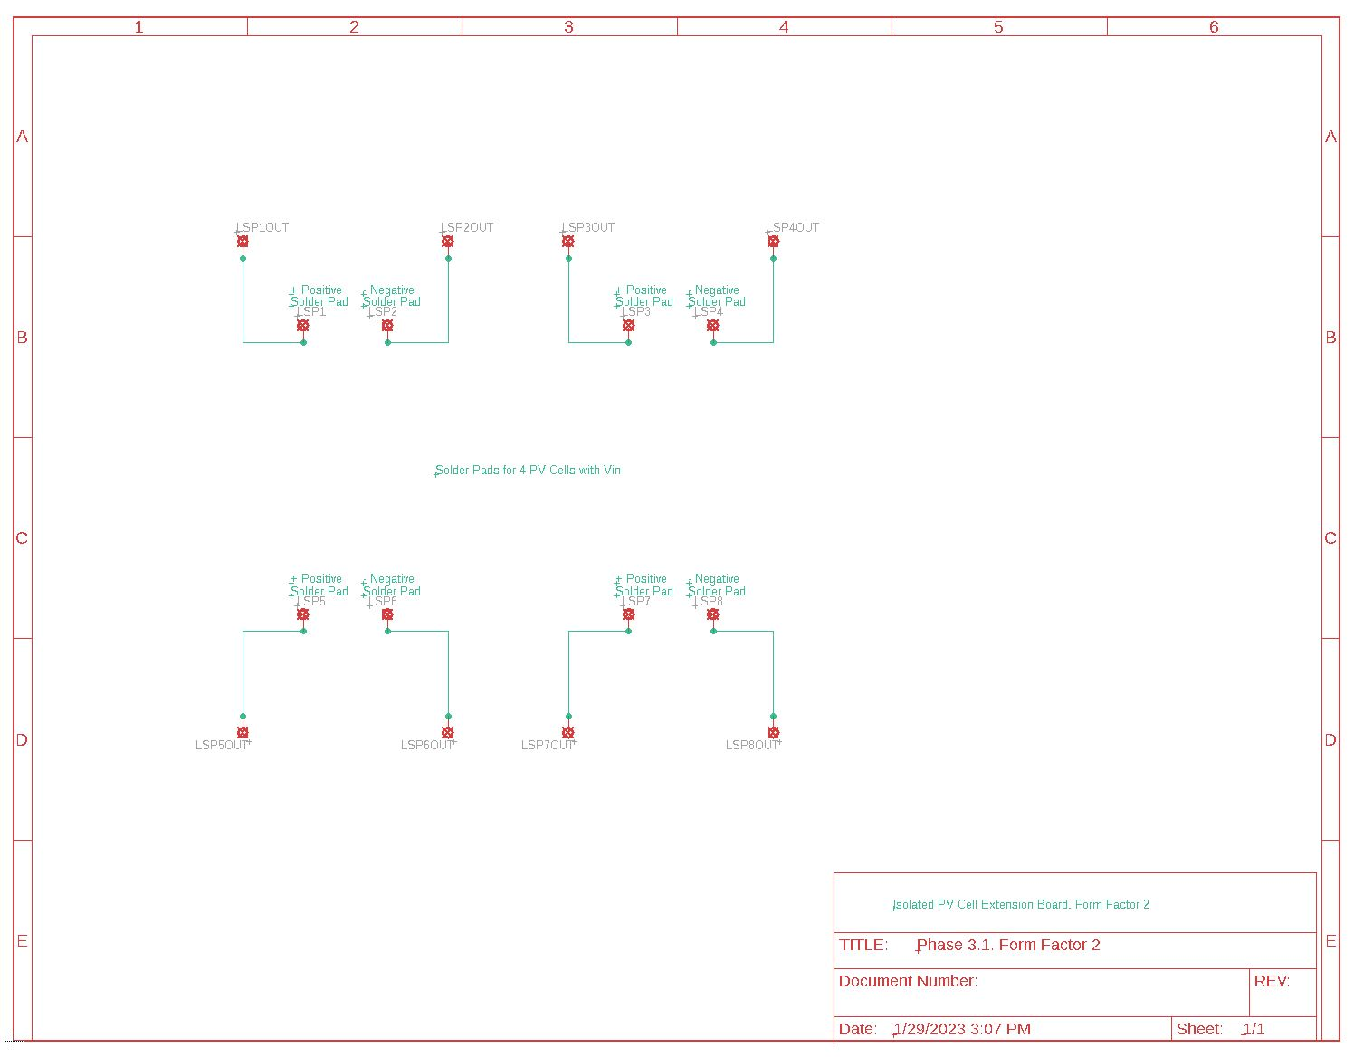
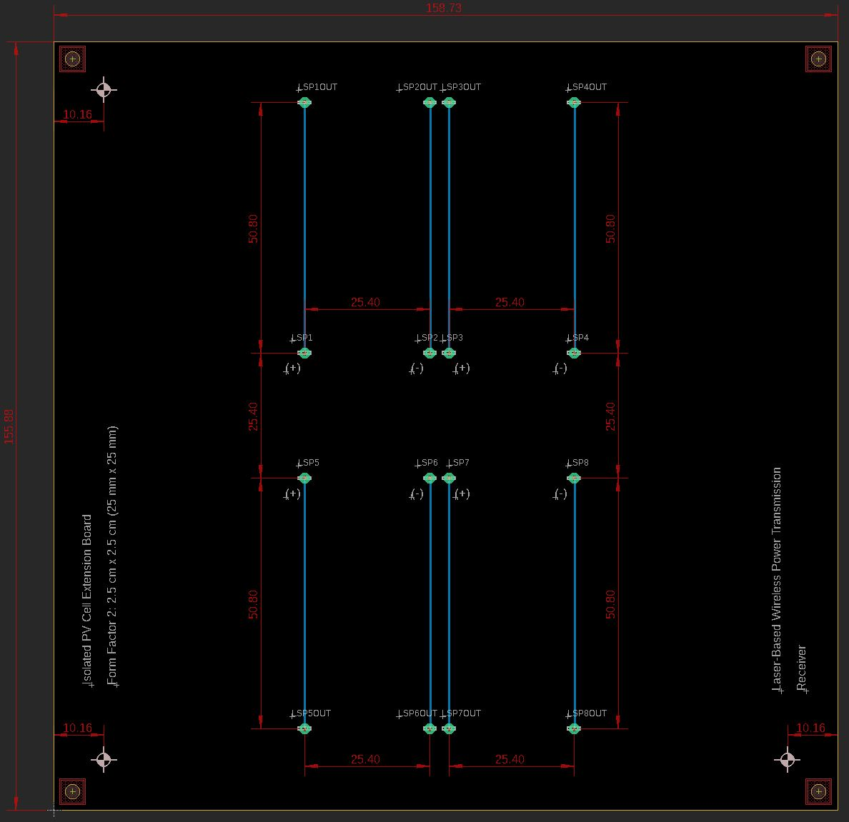
PV Cell Extension Board 2: Form Factor 2: 2.5 cm x 2.5 cm (25 mm x 25 mm)

Slide 7
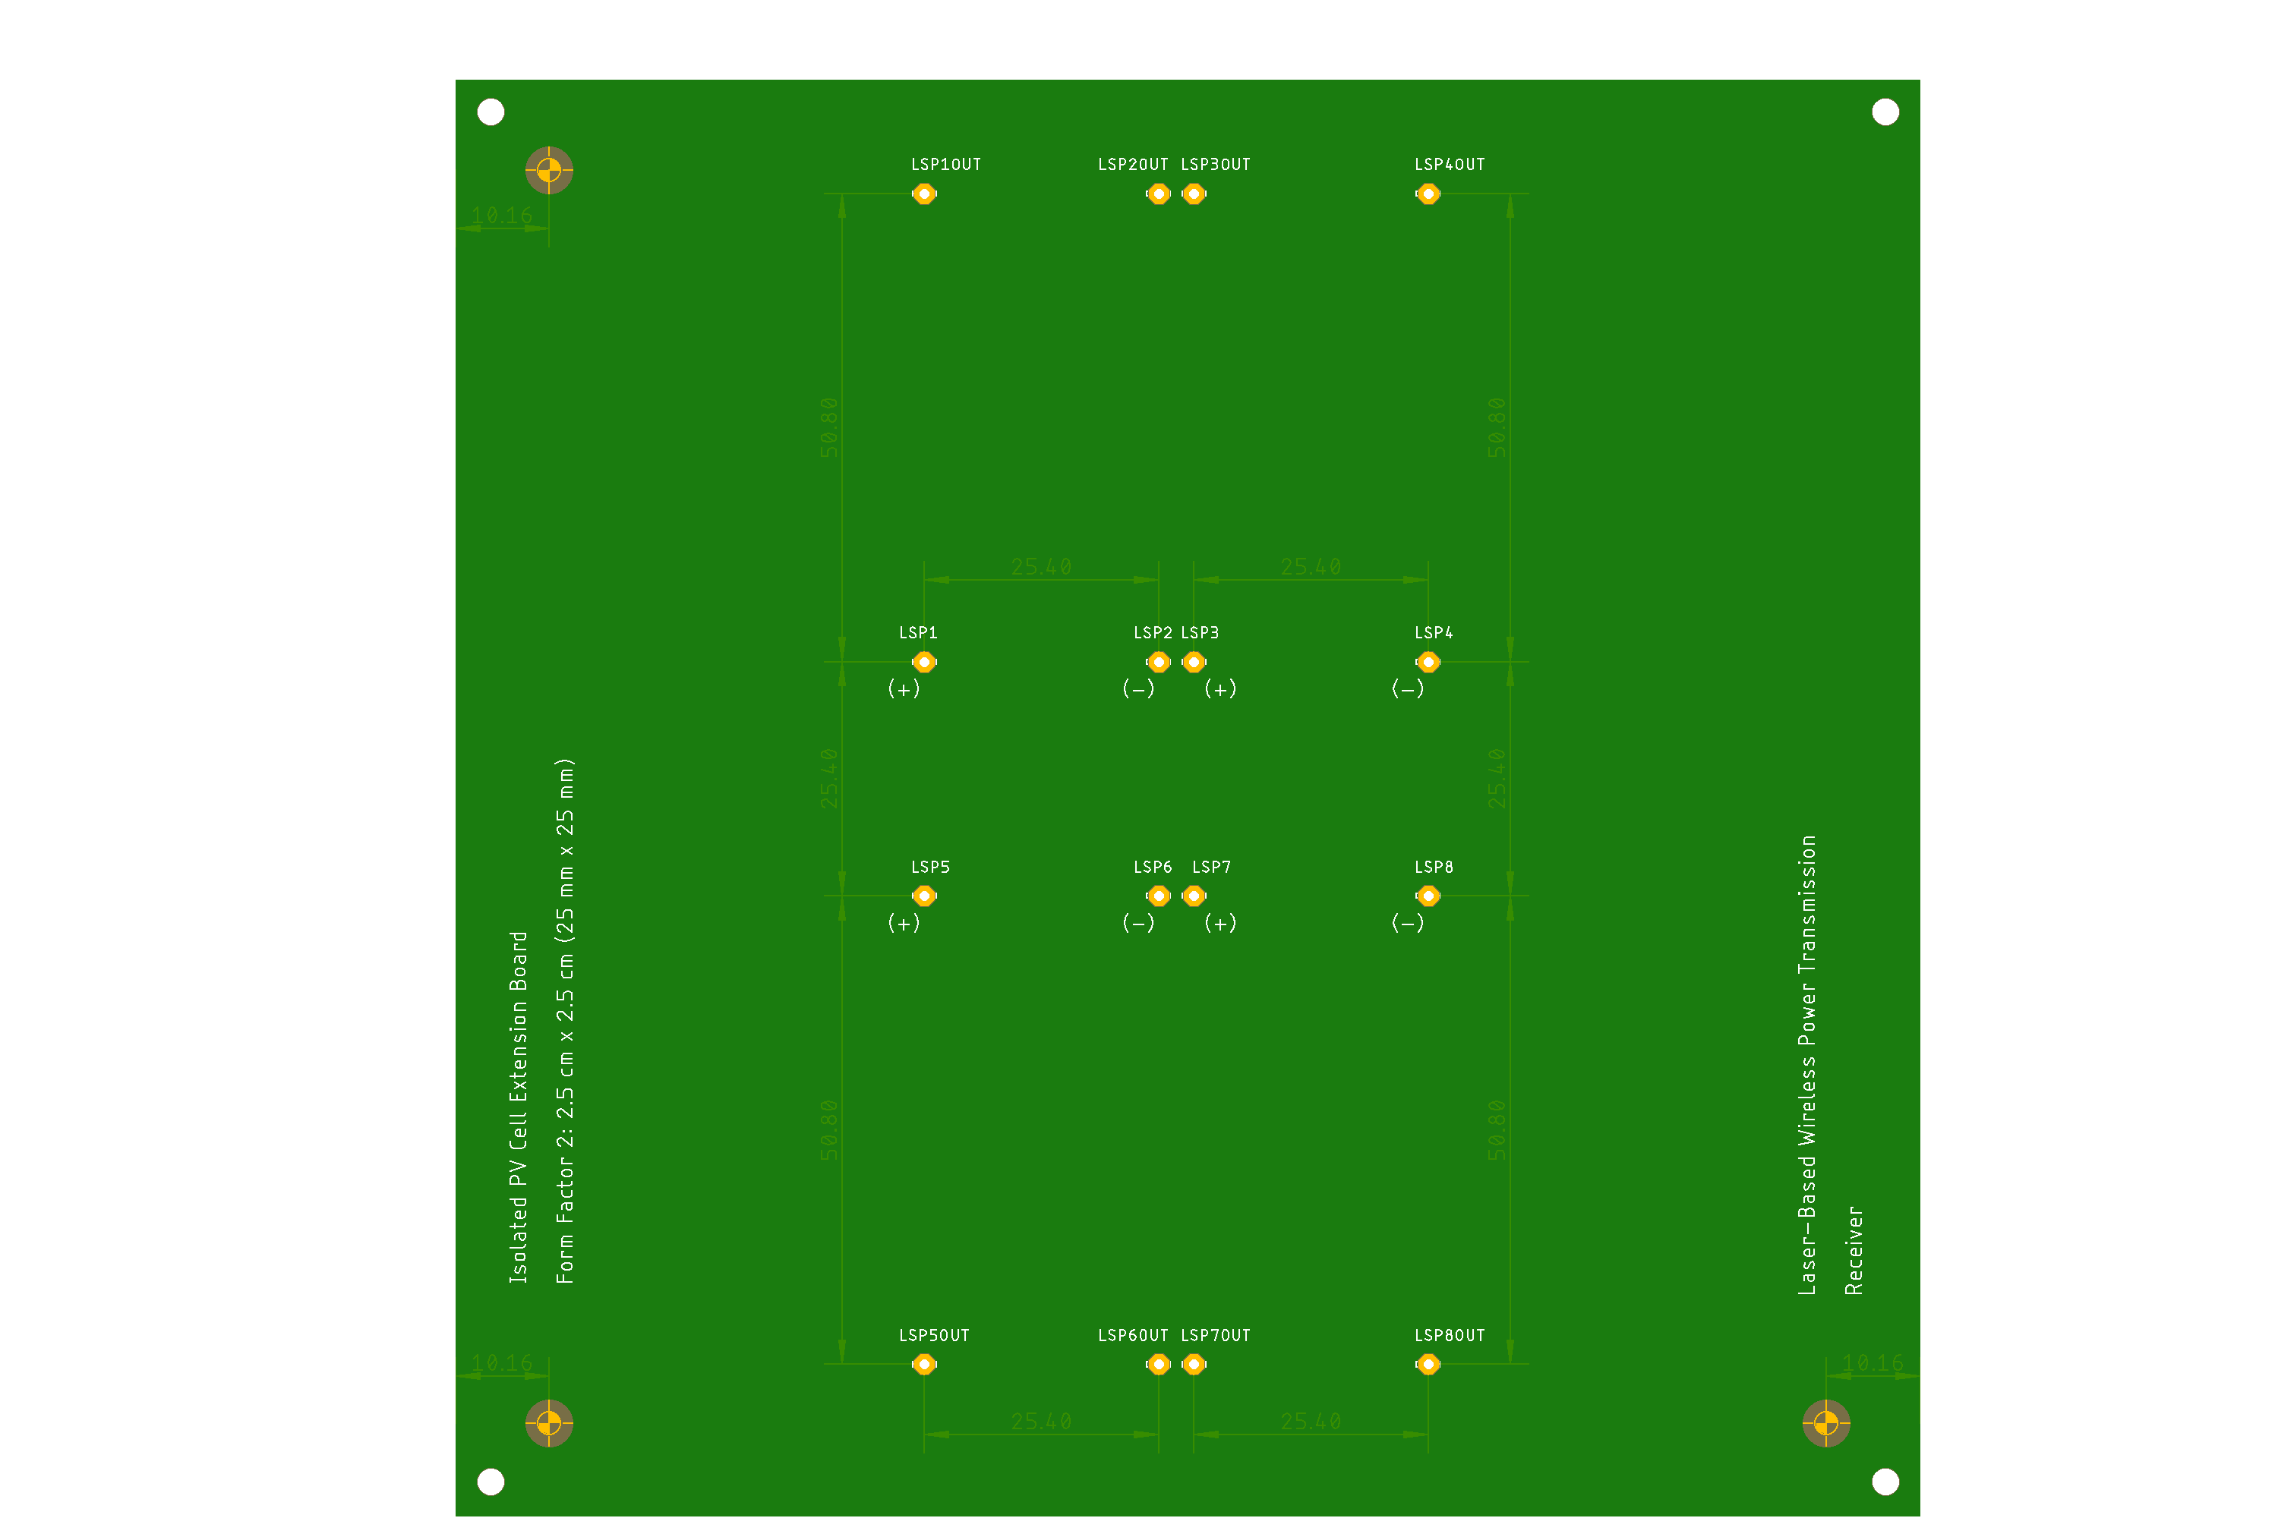
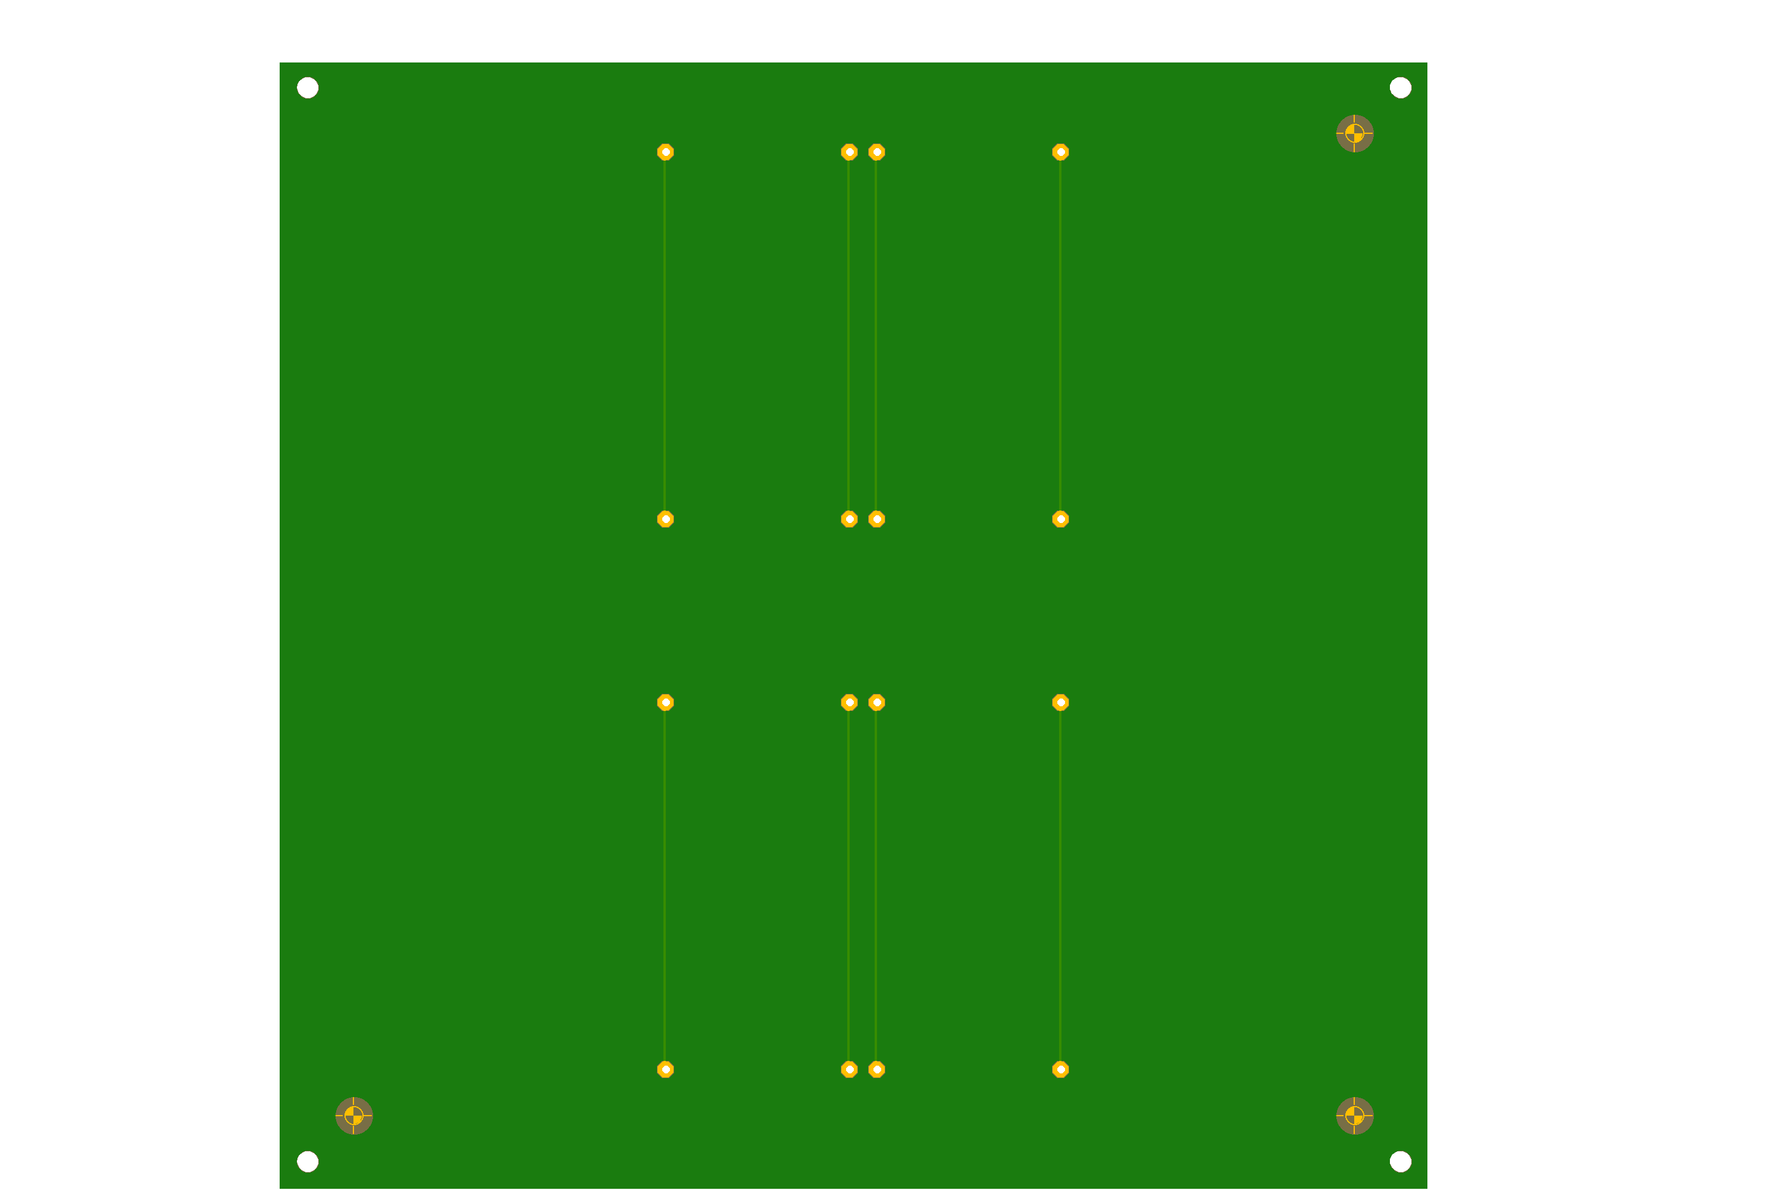
Top
Bottom

Slide 8
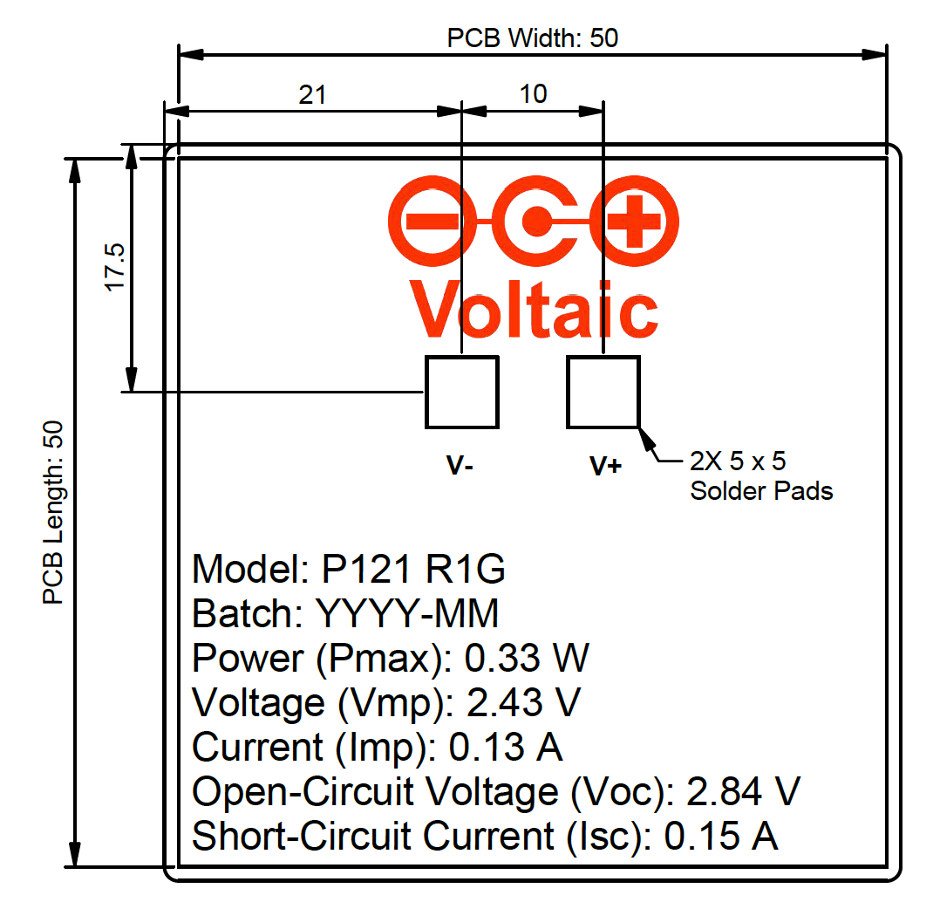
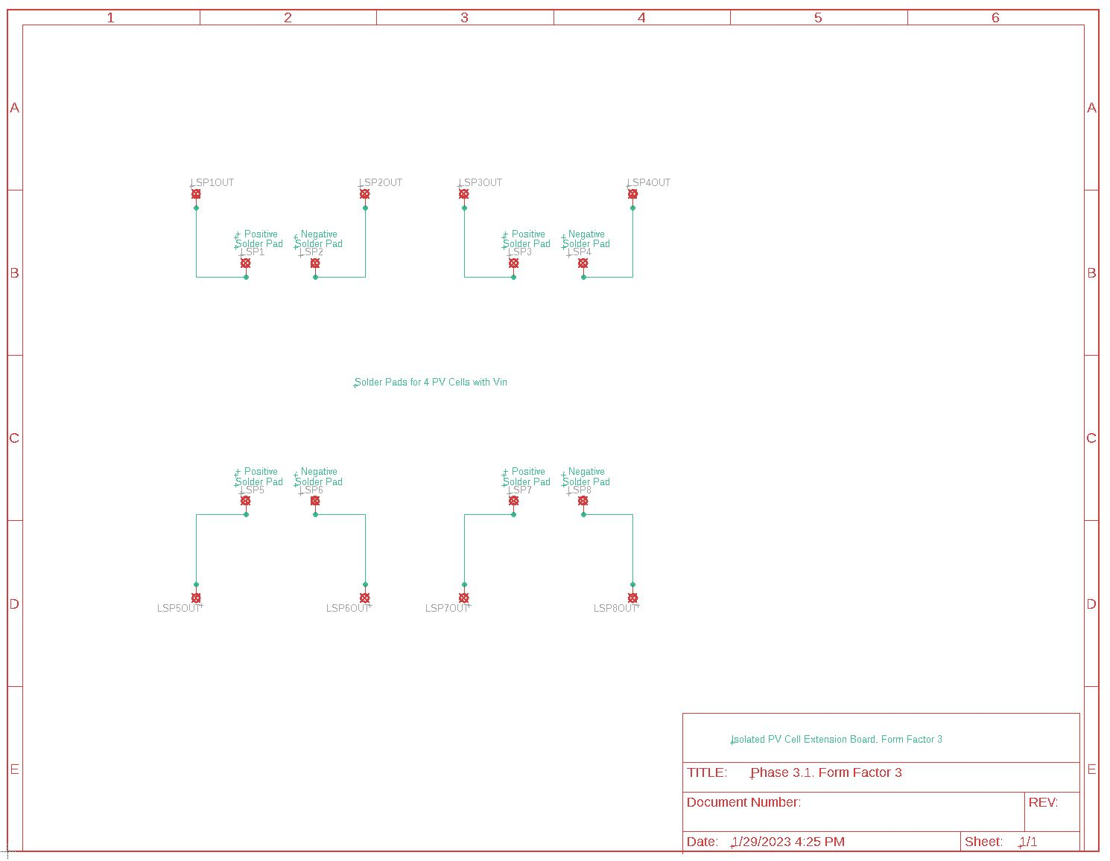
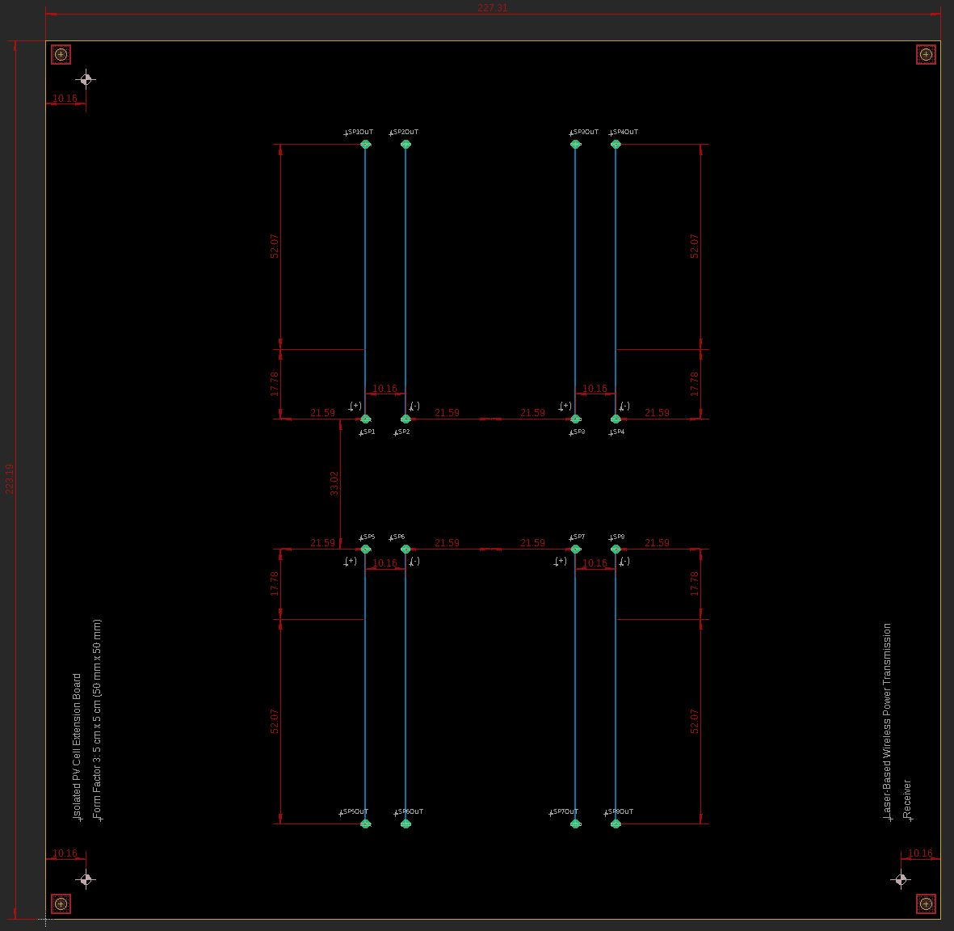
PV Cell Extension Board 3: Form Factor 3: 5 cm x 5 cm (50 mm x 50 mm)

Slide 9
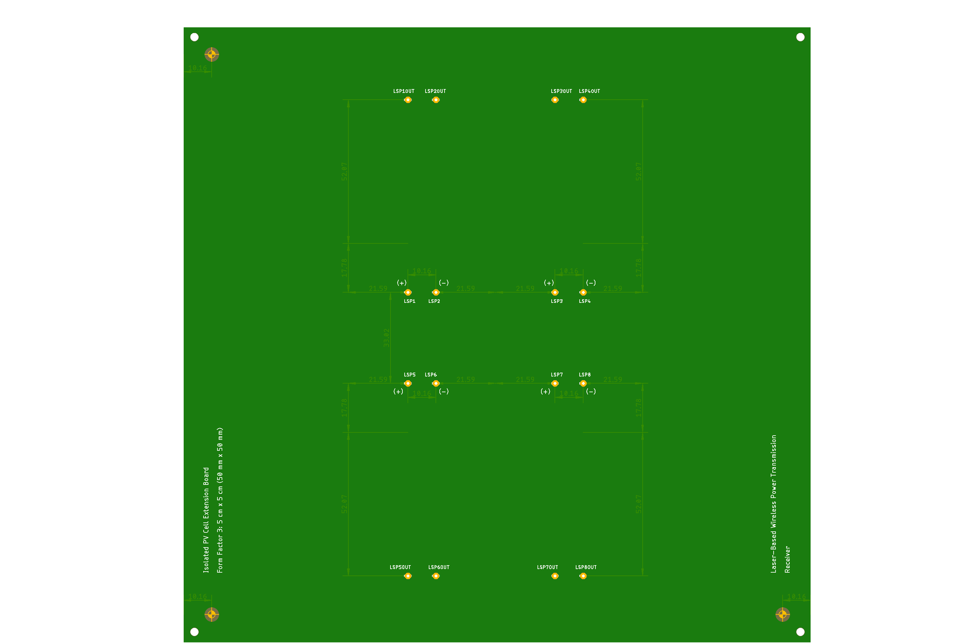
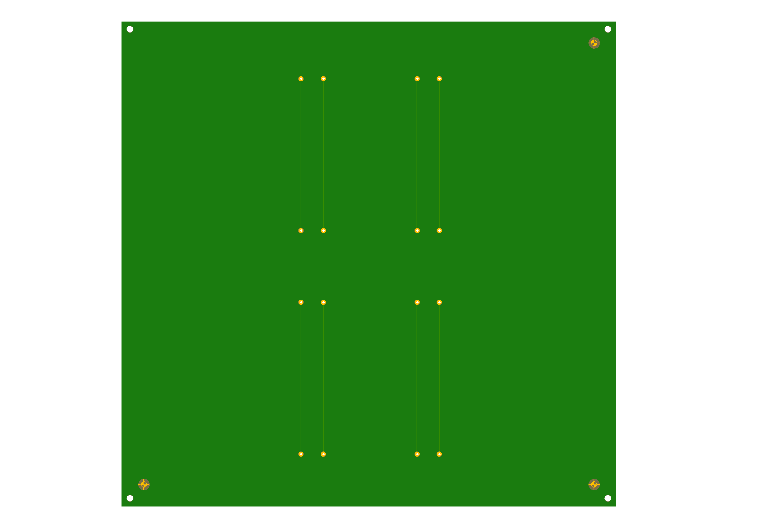
Top
Bottom

